Slide 1


ISQA 8150 Research Project
By Joshua Ellis, Alex Daly, and Satwik Chandra

Slide 2
Agenda
Data Explanation
Descriptive Analysis
Research Question 1 Analysis Method and Findings
Research Question 2 Analysis Method and Findings
Conclusions

Slide 3
Omaha Girls Rock Data
Local non-profit
Focuses on developing girl’s social skills through music programs
Provides survey pre and post programs asking likelihood to do various social activities
Data was processed before models were created

Slide 4
Data Processing

Slide 5
Descriptive Statistics

Slide 6
Are There Significant Differences in Answer Ratings for Various Outcomes in the Younger Group and the Older Group?
Question 1: Which questions (if any) significantly improved after the OGR program between the younger group and older group participants?
Question 2: Is there a statistically significant difference between the delta scores of the Older Group and Younger Group (per question)

Slide 7
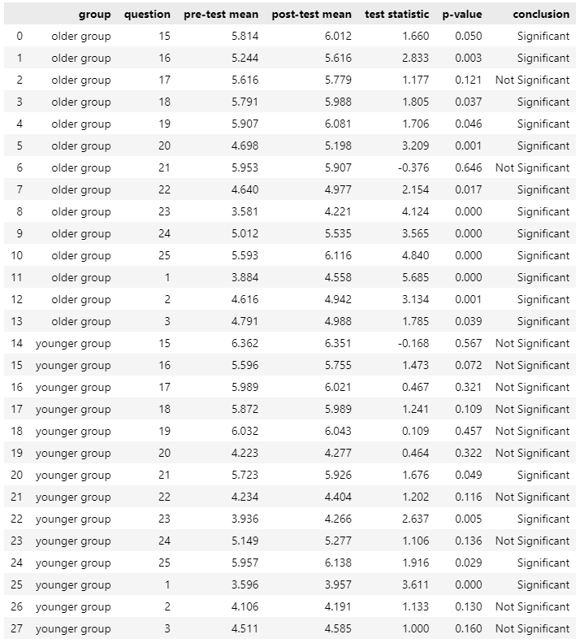
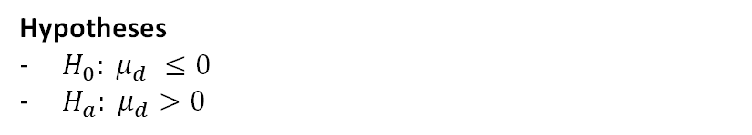
Question 1: Which questions (if any) significantly improved after the OGR program between the younger group and older group participants?
Results
Test
Right-tailed dependent (matched-sample) t-test at a 5% level of significance
Individual test for each question-age group combination (2 groups x 14 questions)
Hypotheses
$H_{0}: μ_{d} ≤0$
$H_{a}: μ_{d}>0$
Conclusion
Program more effective for participants in the older group
Older Group: 12 out of 14 questions have a statistically significant improvement between the pre- and post-test scores.
Younger Group: 4 out of 14 questions have a statistically significant improvement between the pre- and post-test scores.

Slide 8
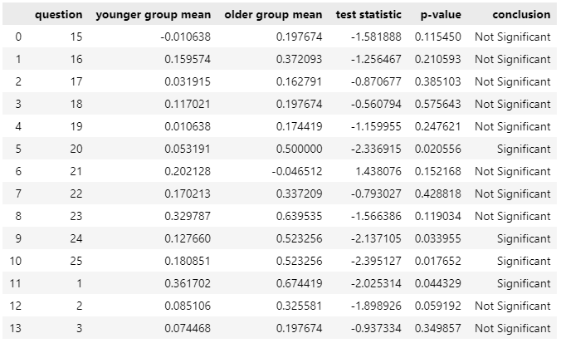
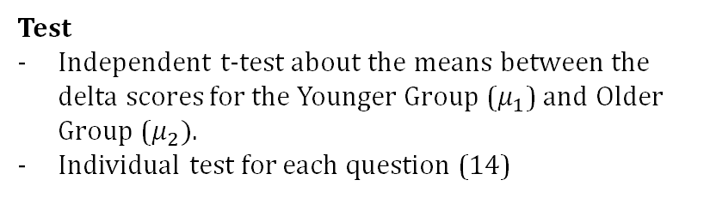
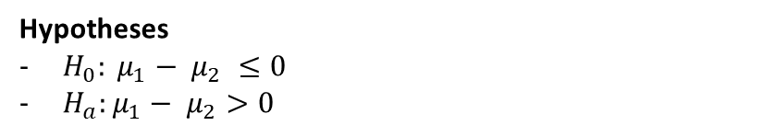
Question 2: Is there a statistically significant difference between the delta scores of the Older Group and Younger Group (per question)
Test
Independent t-test about the means between the delta scores for the Younger Group ($μ_{1}$) and Older Group ($μ_{2})$.
Individual test for each question (14)
Results
Hypotheses
$H_{0}: μ_{1}− μ_{2} ≤0$
$H_{a}:μ_{1}− μ_{2}>0$
Conclusion
There is not a statistically significant difference between the delta scores for the younger group and the older group for most of the questions.
Only samples for questions 20, 24, 25, and 1 provide enough evidence to reject the null hypothesis.
20: Express your feelings to another kid
24: Ask another student for help when you need it
25: Make friends with kids your age
1: You can learn new things, but you can’t really change your basic intelligence

Slide 9
Does the race/ethnicity of participants influence the change in scores for various questions over time?

Slide 10
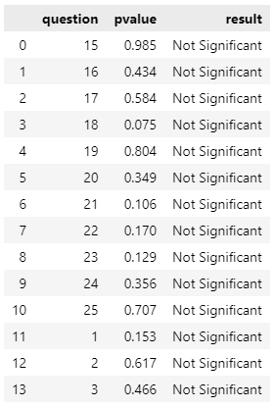
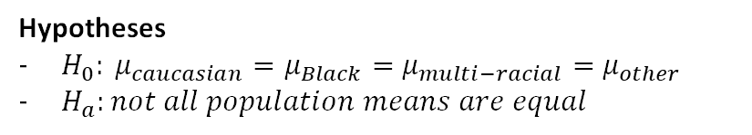
Test
One-way Anova test about the means between the delta scores for the different racial identities
Hypotheses
$H_{0}: μ_{caucasian}=μ_{Black}=$ $μ_{multi−racial}=$ $μ_{other}$
$H_{a}:not all population means are equal$
Results
There is not a statistically significant difference between the delta scores for all the groups, meaning we cannot reject the null hypothesis

Slide 11
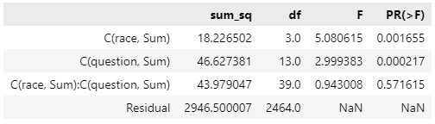
Two-way (factorial Design)
- Race: The average delta differs by race
- question: The average delta differs by question
- Interaction: The interaction between race and question is not significant

Slide 12
Conclusion:

Slide 13
Conclusions

